Slide 1

GENETIC DISORDER PREDICTION USING MACHINE LEARNING
Course code: CSE 589
Presented By​
AADRITA NANDY
Registration Number: 1200752
Lovely Professional University, PUNJAB
Supervisor: Parshotam (UId: )

Slide 2

CONTENTS
Abstract
Introduction
Objectives Of The Work Done
Literature Review
Proposed Work
Methodology Used
Comparison Of Algorithms Performance
Results
Novelty Of Project/Paper
Gap Filled By Project/Research
Conclusion
Future Scope
References

Slide 3

ABSTRACT
Genetic mutation classification is vital for disease understanding and diagnosis, especially in cancer. Only a few mutations (called driver mutations) contribute to cancer progression; most are passenger mutations.
Manual classification is time-consuming and requires expertise and literature review. This study applies Machine Learning (ML) to automate mutation classification using genomic data.
Algorithms used:
K-Nearest Neighbors (KNN)
Random Forest
Achieves high accuracy and generalization in mutation classification.
Introduces a protein-level DNA sequence comparison method:
Converts DNA to protein
Computes similarity index
Detects disease-linked mutations
Highlights the role of ML and bioinformatics in:
Enhancing genomic analysis
Enabling faster diagnostics
Supporting personalized medicine

Slide 4

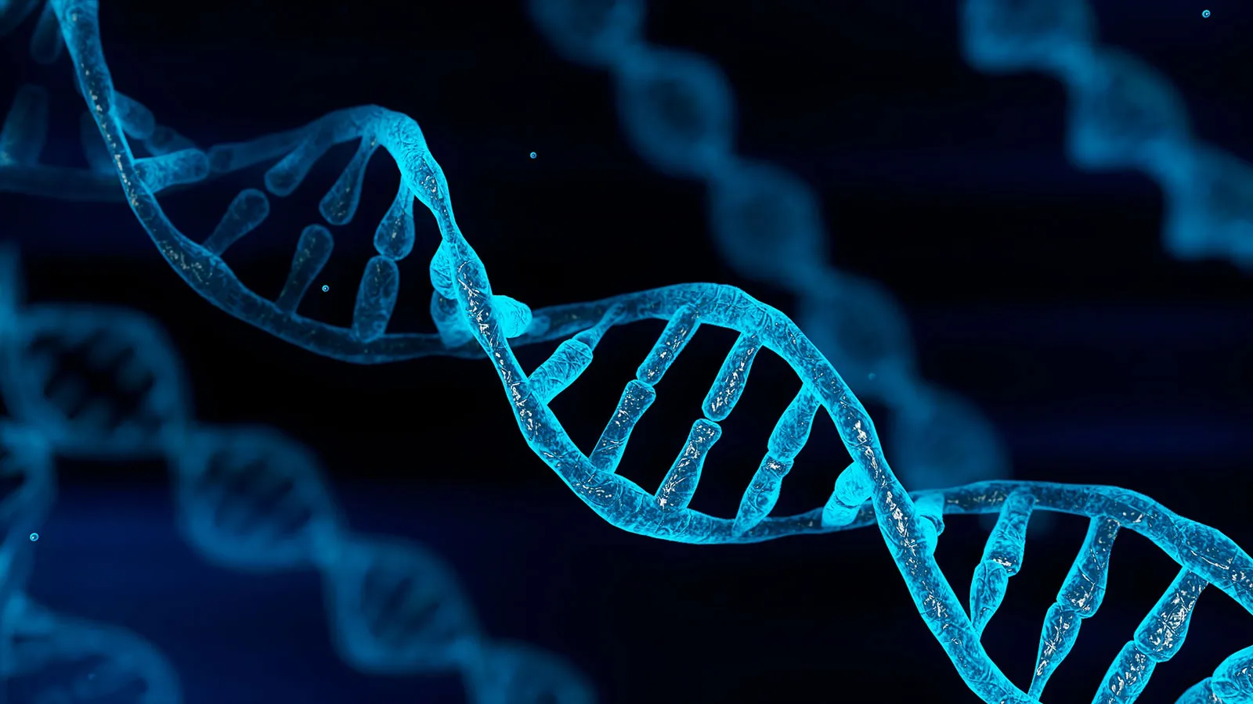
WHAT IS Gene?
INTRODUCTION

Slide 5
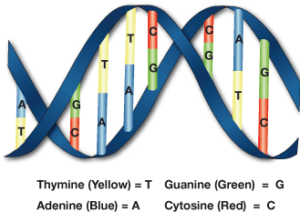
Genes and Genetic Mutations
Genes are fundamental units of heredity.
Composed of specific DNA sequences that guide protein synthesis and regulate cellular functions.
DNA is made up of four nucleotides:
Adenine (A)
Thymine (T)
Cytosine (C)
Guanine (G)
These nucleotides form sequences that determine protein structure via transcription and translation.
A genetic mutation is any change in the DNA sequence.
Mutations can be:
Natural or caused by external factors (e.g., radiation, chemicals, viruses).
Effects of mutations range from harmless to causing serious diseases.

Slide 6
OBJECTIVES

Slide 7
LITERATURE REVIEW
Author Name | Technique Used | Data Type | Key Contribution | Limitation
Sharma et al. (2020) [21] | SVM, Random Forest | Gene expression profiles | High accuracy for binary classification of disease genes | Needs labeled data
Patidar et al. (2021) [20] | Deep Learning (CNN, RNN) | DNA sequence + clinical records | Captures sequential data relationships | High computational cost
Pal (2022) [19] | Codon-based protein similarity | Protein-level translation | Identifies functional mutations with high resolution | Limited dataset diversity
Zhang et al. (2021) [23] | NLP + Knowledge Graph | Medical texts + literature | Extracts gene-disease associations from unstructured data | Relies on NLP accuracy
Singh et al. (2019) [22] | Logistic Regression | SNPs, genomic variants | Interpretable model for risk assessment | Less accurate than deep models
Johann Faouzi (2022) [24] | Recurrent Neural Network, Logistic Regression | PPMI, DIGPD | RNN achieved 86%, 78.5%; Logistic Regression: 84.1%, 64.5% | Potential overfitting, limited dataset diversity

Slide 8
PROPOSED WORK
1. Driver Mutation Classification
Focuses on distinguishing driver mutations (disease-causing) from passenger mutations (harmless).
Uses Machine Learning (ML) models like K-Nearest Neighbors (KNN) and Random Forest.
Dataset sourced from MSK Cancer Center.
Key techniques:
Class imbalance handling using calibrated classifiers.
Hyperparameter tuning for improved accuracy.
Ensures interpretability for clinical use by healthcare professionals.
2. Disease-Associated Mutation Detection via Protein-Level Analysis
Addresses limitations of traditional nucleotide-level comparisons.
Converts DNA sequences to protein sequences to assess functional impact.
Calculates a similarity index to detect pathogenic mutations.
Enhances mutation detection resolution and supports genetic disorder prediction.

Slide 9
METHODOLOGY USED

Slide 10
METHODOLOGY USED

Slide 11
COMPARISION OF ALGIRITHMS PERFORMANCE

Slide 12
RESULTS

Slide 13
PROPOSED WORK

Slide 14
OBJECTIVES

Slide 15
OBJECTIVES

Slide 16
ABSTRACT

Slide 17
Selecting visual aids
Enhancing your presentation

Slide 18
Navigating Q&A sessions
Know your material in advance
Anticipate common questions
Rehearse your responses
Maintaining composure during the Q&A session is essential for projecting confidence and authority. Consider the following tips for staying composed:
Stay calm
Actively listen
Pause and reflect
Maintain eye contact

Slide 19

Speaking impact
Your ability to communicate effectively will leave a lasting impact on your audience
Effectively communicating involves not only delivering a message but also resonating with the experiences, values, and emotions of those listening

Slide 20
Dynamic delivery
Learn to infuse energy into your delivery to leave a lasting impression.
One of the goals of effective communication is to motivate your audience.
Metric | Measurement | Target | Actual
Audience attendance | # of attendees | 150 | 120
Engagement duration | Minutes | 60 | 75
Q&A interaction | # of questions | 10 | 15
Positive feedback | Percentage (%) | 90 | 95
Rate of information retention | Percentage (%) | 80 | 85

Slide 21

Overcoming nervousness
Confidence-building strategies

Slide 22
LITERATURE REVIEW

Slide 23
Thank you

